Slide 1
Program 4
Discussion

Slide 2
Use ranked choice to generate a winner
Preferences are generated by ordinal and cardinal values:
The starter code allows the user to select number of voters and number of candidates. It uses a seed so everyone will have the same input (so results should be comparable)
The starter code generates the preference of each voter for each candidate by generating a random number between 1 and 10. The higher the number, the higher the preference
Candidates are numbers.
The format of the list is [candidate, score, ranking]. So Alice gave a score to candidate 1 of 2.5 (which was her 5th choice) and a score of 5.5 to candidate 2 which was her 4th choice.
The complete order of candidates for Alice is [4, 5, 3, 2, 1] which means candidate 4 is her first choice.
Voters are named:
Alice [1, 2.5, 5][2, 5.5, 4][3, 6.0, 3][4, 9.0, 1][5, 8.9, 2] ORDER [4, 5, 3, 2, 1]
Bart [1, 6.6, 2][2, 1.8, 5][3, 2.6, 4][4, 5.7, 3][5, 8.9, 1] ORDER [5, 1, 4, 3, 2]
Cindy [1, 4.0, 4][2, 6.7, 3][3, 1.6, 5][4, 8.5, 1][5, 7.2, 2] ORDER [4, 5, 2, 1, 3]
Darin [1, 3.0, 3][2, 5.1, 1][3, 2.3, 5][4, 4.8, 2][5, 2.9, 4] ORDER [2, 4, 1, 5, 3]
Elmer [1, 3.0, 4][2, 9.5, 1][3, 4.3, 3][4, 7.7, 2][5, 3.0, 5] ORDER [2, 4, 3, 1, 5]
Finn [1, 5.5, 4][2, 6.0, 3][3, 6.2, 2][4, 1.6, 5][5, 8.3, 1] ORDER [5, 3, 2, 1, 4]
Greg [1, 6.6, 1][2, 6.5, 2][3, 5.2, 3][4, 4.4, 4][5, 4.4, 5] ORDER [1, 2, 3, 4, 5]

Slide 3
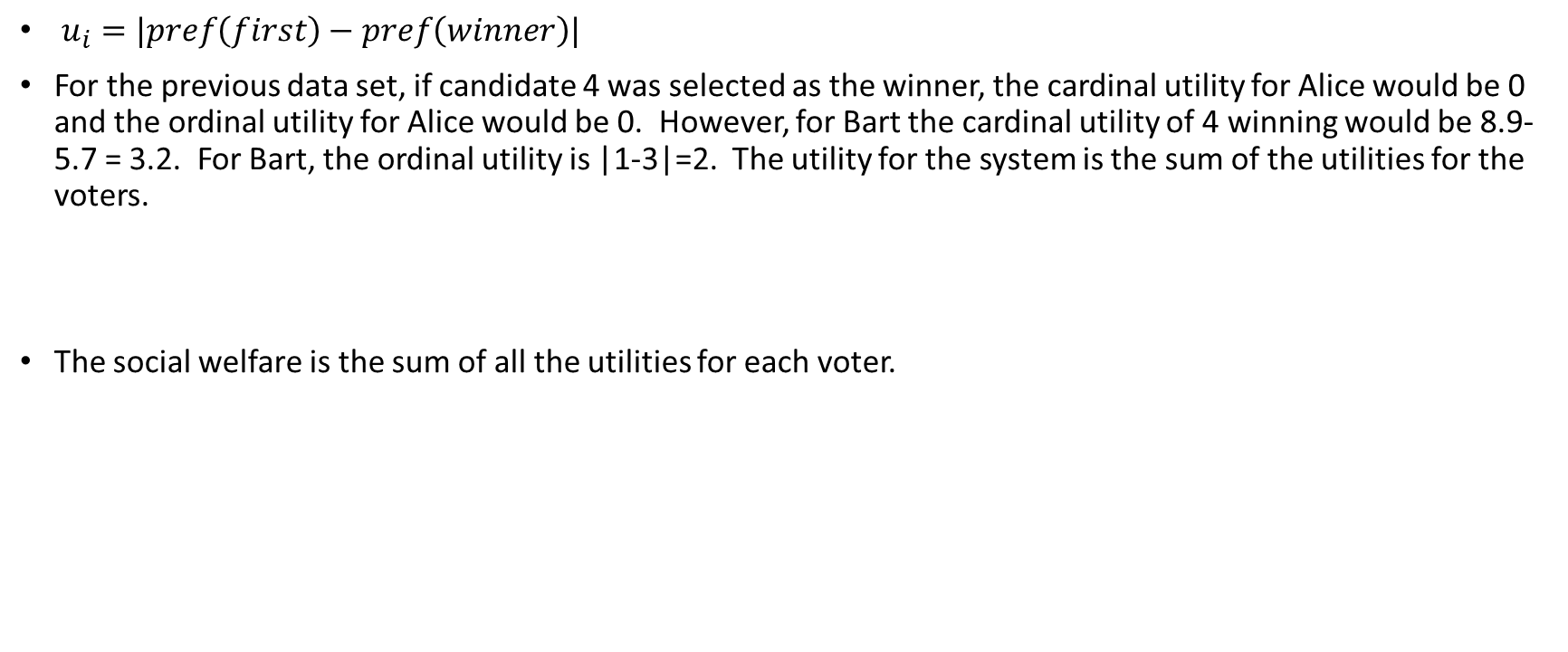
Social welfare of choice
$u_{i}=$ $|pref\left(first\right)−pref\left(winner\right)|$
For the previous data set, if candidate 4 was selected as the winner, the cardinal utility for Alice would be 0 and the ordinal utility for Alice would be 0. However, for Bart the cardinal utility of 4 winning would be 8.9-5.7 = 3.2. For Bart, the ordinal utility is |1-3|=2. The utility for the system is the sum of the utilities for the voters.
The social welfare is the sum of all the utilities for each voter.

Slide 4
Part 1
Output the preference matrix (as above). List the order in which candidates are eliminated.
Output the winner using ranked choice voting.
Output the social welfare for the system given the winner using both cardinal and ordinal utility.
Voters rank all candidates in order of their preference. When tallying the votes, the first-choice candidates of all voters go up against each other and the candidate with the least first-choice votes is eliminated. Break ties by eliminating the candidate with the most last-choice votes.
The ballots that ranked the eliminated candidate first are redistributed to the candidate they ranked second, and the process is repeated, eliminating candidates and re-tallying ballots until only the winner is leftranked-choice

Slide 5
Part 2
Social network model. Voters are embedded in a social network. Each voter observes the ballots of her neighbors in the network, from which she infers the likely outcome of the election. Each voter may then revise her vote strategically, to maximize her expected utility. Winners are determined by plurality (after a series of rounds).
Real world social networks exhibit a property called homophily; sometimes called “The Echo Chamber Effect”, which is the tendency for friends to have similar ideologies.
You can have voters change their mind any reasonable way. Be sure you explain how you decided.
How should the voter use the knowledge about other voters:
Everyone else seems to like my last choice. There is no reason to change my vote.
The other voters are split. Several like my second choice and several like my third choice. Changing my vote to my second choice would give them a better chance of winning. My first choice seems to have no chance.
Other ideas?

Slide 6
 | Alice | Bart | Cindy | Darin | Elmer | Finn | Greg
Alice | 0 | 0 | 1 | 0 | 0 | 0 | 0
Bart | 0 | 0 | 0 | 1 | 0 | 0 | 0
Cindy | 0 | 0 | 0 | 0 | 1 | 0 | 0
Darin | 0 | 0 | 1 | 0 | 1 | 0 | 0
Elmer | 0 | 0 | 0 | 0 | 0 | 0 | 1
Finn | 0 | 0 | 0 | 0 | 1 | 0 | 1
Greg | 0 | 1 | 1 | 0 | 0 | 1 | 0
Alice 0 0 1 0 0 0 0
Bart 0 0 0 1 0 0 0
Cindy 0 0 0 0 1 0 0
Darin 0 0 1 0 1 0 0
Elmer 0 0 0 0 0 0 1
Finn 0 0 0 0 1 0 1
Greg 0 1 1 0 0 1 0

Slide 7
Show the connection matrix.
Using the social network model, show how many voters change their mind at each round.
Output the winner.
List the social welfare of your solution using both ordinal and cardinal method (using their original votes). Social welfare should be based on actual preference, not reported preference.

Slide 8
Extra (Required for 6110, bonus 4 points for 5110)
Compare the solution obtained by Borda with these two methods (ranked-choice and social networks). You may find it interesting to compare results for between 10 and 50 voters. How often do all three methods give the same result? On average, what method yields the best utility?
Would you get better more interesting results if connections were more in clusters than determined randomly? Why? When we determine things randomly, we can’t capture common situations like clusters of friend groups or some candidates being more appealing than others.

